Slide 1
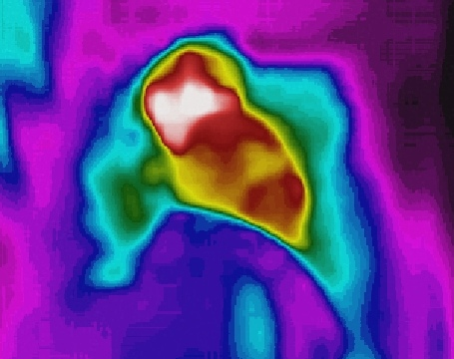
AIoT Bedroom
Au Ka Long(04)
Project ID: P21

Slide 2

Problem & Solution

Slide 3


Problem
Find these problem from these memes
These problems are in our daily life
Try to solve them with AI and IoT

Slide 4


Furthermore
Try to create a safe and relaxing place
Total relaxation
Worry-free

Slide 5
Solution
Socket
AI analysis (Yolo v5)
Software
Android App
Send data from Thermal Camera
PC
Get data
Visual image
Thermal image
Algorithms
Detection
IoT Automation

Slide 6
Solution
Thermal Camera
Thermal Image
Visual Image
Network
PC
CPU/GPU
Network
Hardware
IoT devices
Automation

